Slide 1
Bank Capital

Slide 2
What is bank capital?
Capital or net worth equals the cumulative value of assets minus the cumulative value of liabilities and represents the ownership of the firm
It is traditionally measured on a book value basis where assets and liabilities are listed in terms of historical cost
In banking regulators include certain forms of debt and loan loss reserves while measuring capital adequacy ratio

Slide 3
Constituents of Bank Capitals
Common stocks equal the par value of common stock outstanding
Preferred stocks measured by the par value of any shares outstanding that promise to pay a fixed rate of return
Surplus equals the excess amount above each share of stock’s par value paid
Undivided profit is the net earnings that have been retained in the business rather than being paid out as dividend
Equity reserves representing funds set aside for contingencies such as legal action against institution, expected dividends to be paid etc.

Slide 4
Constituents of Bank Capitals …
Subordinated debentures represent long-term debt capital contributed by outside investors. This instrument may carry a convertible feature, permitting their future exchanges for shares of stock.
Minority interest in consolidated subsidiaries where the financial firm holds ownership shares in other businesses
Equity commitment notes, which are debt securities repayable from the sale of the stock

Slide 5
Importance of Bank Capital
Provides cushion for banks to absorb losses and remain solvent
Provides ready access to financial markets
Guards against liquidity problems caused by the deposit outflows
Reduces risk of failure
Increases the public confidence

Slide 6
Relative importance of Different Sources of Capital
Surplus market value of common and preferred stocks
Retained earnings
Long term debt
The relative importance of different components varies across the size of banks

Slide 7
How much capital a bank should hold?
Who should set capital standards, market or regulatory agencies?
What is a reasonable standard for the proper amount of capital?
Bank capital is regulated
To limit the risk of failures
To preserve public confidence
To limit losses to the government arising from deposit insurance claim

Slide 8
The Basel Agreement: Basel I
The Basel Agreement of 1988 includes risk-based capital standards designed to:
Encourage banks to keep their capital positions strong
Reduce inequalities in capital requirements between countries
Promote fair competition
Account for financial innovations (OBS, etc.)
Stockholders' equity is deemed to be the most valuable type of capital
Minimum capital requirement increased to 8% total capital to risk-adjusted assets

Slide 9
The Basel Agreement: Basel I
A Bank’s Minimum Capital Requirement is Linked to its Credit Risk
The greater the credit risk, the greater the required capital
Capital is divided into Two Tiers
Basel I required bankers to determine the current market value for a contract that is similar to the contract they have actually made with a customer in order to figure out the latter’s replacement cost.

Slide 10
The Basel Agreement: Basel I
Tier I Capital | Tier II Capital
Common stock and surplus Undivided profits (retained earnings) Qualifying noncumulative perpetual preferred stock Minority interests in the equity accounts of consolidated subsidiaries Selected intangible assets less goodwill and other intangible assets | Allowance (reserves) for loan and lease losses Subordinated debt capital instruments Mandatory convertible debt Intermediate-term preferred stock Cumulative perpetual preferred stock with unpaid dividends Equity notes Other long term capital instruments that combine debt and equity features
Total Regulatory Capital: Tier 1 Capital + Tier 2 Capital – investments in unconsolidated subsidiaries – capital securities held by the bank that were issued by other depository institutions and are held under a reciprocity agreement – activities pursued by savings and loan association that may have been acquired by a banking organization but are not permissible for national banks – other items

Slide 11
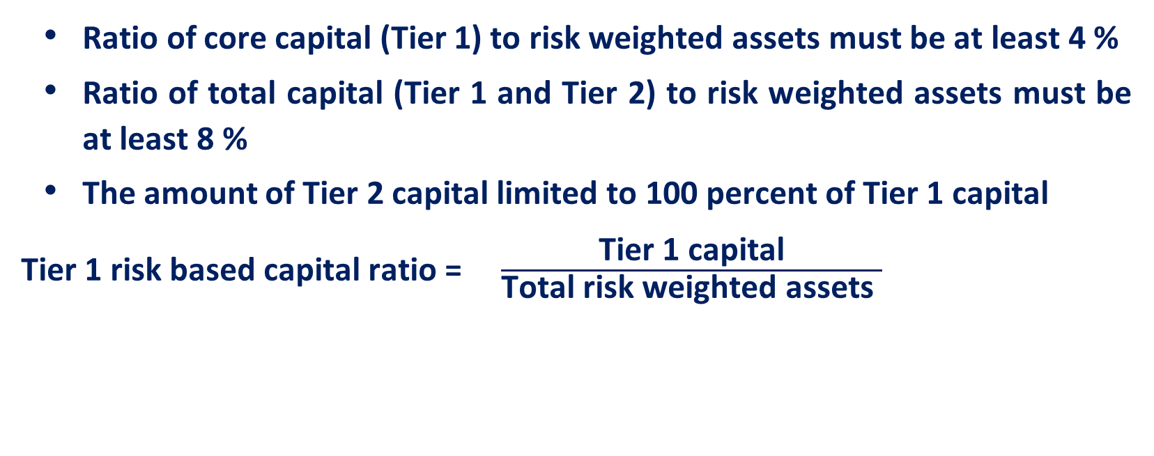
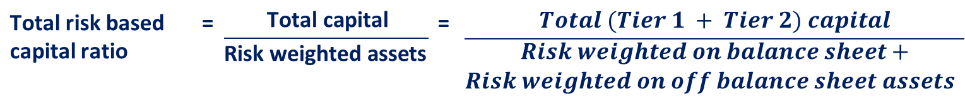
Basel I: Capital Requirements
Ratio of core capital (Tier 1) to risk weighted assets must be at least 4 %
Ratio of total capital (Tier 1 and Tier 2) to risk weighted assets must be at least 8 %
The amount of Tier 2 capital limited to 100 percent of Tier 1 capital
Tier 1 risk based capital ratio = $\frac{\text{Tier}\text{ 1 }\text{capital}}{\text{Total} \text{risk} \text{weighted} \text{assets} }$
Total risk based capital ratio | = | $$\frac{\text{Total} \text{capital}}{\text{R}\text{isk} \text{weighted} \text{assets} }$$ | = | $$\frac{Total (Tier 1 + Tier 2) capital}{\begin{aligned}Risk weighted on balance sheet+ \\ Risk weighted on off balance sheet assets \end{aligned}}$$

Slide 12
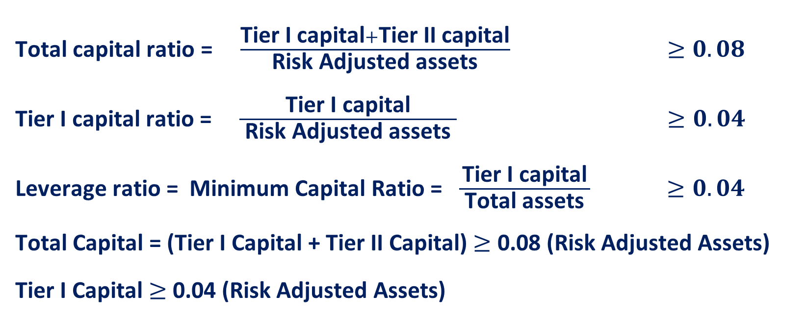
Basel I: Capital Requirements
Total capital ratio = $\frac{\text{Tier} \text{I} \text{capital}+\text{Tier} \text{II} \text{capital}}{ \text{R}\text{isk} \text{Adjust}\text{ed} \text{assets} } ≥0.08$
Tier I capital ratio = $\frac{\text{Tier} \text{I} \text{capital}}{ \text{R}\text{isk} \text{Adjust}\text{ed} \text{assets} } ≥0.04$
Leverage ratio = Minimum Capital Ratio = $\frac{\text{Tier} \text{I} \text{capital}}{ \text{Total} \text{assets} } ≥0.04$
Total Capital = (Tier I Capital + Tier II Capital) $≥$ 0.08 (Risk Adjusted Assets)
Tier I Capital $≥$ 0.04 (Risk Adjusted Assets)

Slide 13
Basel I: Capital Requirements
Basel I dictated there should be 4 Risk Groups of Assets
1. 0.00 items→ 0 % Risk weighting category
2. 0.20 items → 20 % Risk weighting category
3. 0.50 items → 50 % Risk weighting category
4. 1.00 items → 100 % Risk weighting category
As the credit risk increases so does the capital requirement
The same 0.00; 0.20; 0.50 and 1.00 apply to off-balance sheet items.

Slide 14
Basel I: Risk Weights Applied to Bank Assets & OBS
Credit Risk Categories for Bank Assets on the Balance Sheet
Credit Risk Weights Used in the Calculation of a Bank’s Risk-Weighted Assets (percentage of amount of each asset) | Assumed Amount of Credit Risk Exposure from Each Category of Bank Assets | Examples of Types of Bank Assets in Each Credit-Risk Category
0% | Zero credit risk | Cash deposits at the Reserve Banks; Treasury bills, notes and bonds of all maturities, Government National Mortgage Association (GNMA) mortgage backed securities; and debt securities issued by governments of the world’s leading industrial countries.
20% | Low credit risk | Interbank (correspondent) deposits, general obligation bonds and notes issued by states or backed by government agencies, and mortgage-backed securities issued or guaranteed by the Federal National Mortgage Association (FNMA) or by the Federal Home Loan Mortgage Corporation (FHLMC)
50% | Moderate credit risk | Residential mortgage loans and revenue bonds issued by state and local government units or agencies
100% | Highest credit risk | Commercial and industrial (business) loans, credit card loans, real property, investments in bank subsidiary companies, and all other assets not listed previously

Slide 15
Basel I: Off Balance Sheet
Requires bank to divide each contract’s risk into two categories:
Potential Market Risk Exposure:-
Risk exposure refers to the danger of loss at some future time if the customer who earned into a market base contract with the bank fails to perform.
2. Current Market Risk Exposure:-
Risk exposure is designed to measure the risk of loss should a customer default today on its contract, which would compel the bank to replace the failed contract with a new one.

Slide 16
Basel I: Risk Weights Applied to Bank Assets & OBS
Credit Risk Categories for Off Balance Sheet Items
Conversion Factor for Converting Off-Balance-Sheet Items into Equivalent Amounts of On-Balance-Sheet Items | Credit Risk Weights Used in the Calculation of a Bank’s Risk-Weighted Assets (percentage of amount of each asset) | Assumed Amount of Credit Risk | Examples of Types of Off-Balance Sheet Items in Each Credit-Risk Category
0.00 | 0% | Zero credit risk | Loan commitments with less than one year to go
0.20 | 20% | Low credit risk | Standby credit letters backing the issue of state and local government general obligation bonds
0.20 | 100% | Modest credit risk | Trade based commercial letters of credit and banker’s acceptances
0.50 | 100% | Moderate credit risk | Standby credit letters guaranteeing customer’s future performance and unused bank loan commitments longer than a year
1.00 | 100% | Highest credit risk | Standby credit letters issued to back repayment of commercial paper

Slide 17
Basel I: Capital Requirements Attached to Derivatives
Basel I adjusted to account for risk from derivatives-futures, options, interest rate and currency swaps, interest cap and floor contracts and other instruments designed to hedge against changing currency prices, interest rates and positions in commodities
Many of these derivatives exposed a bank to counterparty risk.
Risk for many of these instruments is limited because they are traded in organized exchanges.
Credit-conversion factors for interest rate derivatives are set lower than credit conversion factors for contracts tied to the value of foreign currencies

Slide 18
Basel I: Risk Weights Applied to Bank Assets & OBS
Credit Risk Categories for Derivatives & Other Market-Based Contracts Not Shown on a Bank’s Balance Sheet
Conversion Factor for Converting Interest Rate and Currency into Equivalent Amounts of On-Balance-Sheet Items | Credit Risk Weights (percentage) | Assumed Amount of Credit Risk | Categories or Types of Off-Balance Sheet Currency and Interest Rate Contracts
0.00 | 50% | Lowest credit risk | Interest rate contracts one year or less to maturity
0.005 | 50% | Modest credit risk | Interest rate contracts over one year to maturity
0.01 | 50% | Moderate credit risk | Currency contracts one year or less to maturity
0.05 | 50% | Highest credit risk | Currency contracts over one year to maturity

Slide 19
Basel I: Calculating Risk-Weighted Assets
Compute Credit-Equivalent Amount of Each Off-Balance Sheet (OBS) Item
Find the Appropriate Risk-Weight Category for Each Balance Sheet and OBS Item
Multiply Each Balance Sheet and Credit-Equivalent OBS Item By the Correct Risk-Weight
Add to Find the Total Amount of Risk-Weighted Assets

Slide 20
Calculating Risk Weighted Assets Under Basel I
Suppose a bank has Rs.6000 in total capital, Rs. 100,00- in total assets, and the following on-balance-sheet and off-balance-sheet (OBS) items
On Balance Sheet Items (Assets)
Cash Treasury securities Deposit balances held at domestic banks Loans secured by first liens on 1- to- 4 family residential properties Loans to private corporations Total balance sheet assets | Rs. 5,000 20,000 5,000 5,000 65, 000 Rs. 100,000
Off-Balance –Sheet –Items
Stand by letter of credit backing municipal and corporate borrowings Long-term, legally binding credit commitments to private companies Total off-balance-sheet items | Rs. 10,000 20,000 Rs. 30,000

Slide 21

Calculating Risk Weighted Assets Under Basel I
Banks total capital to total balance sheet asset ratio = $\frac{\text{6000}}{\text{100000}}=6.00\%$
Calculation of risk weighted assets:
Step I: Calculate the credit equivalent amount of each off balance sheet (OBS) item
Off-Balance Sheet Item | Face Value |  | Conversion factor |  | Credit Equivalent Amt.
Stand by letter of credit backing municipal and corporate borrowings, asset sales with recourse and repurchase agreement, and forward asset purchases Long-term, legally binding credit commitments to private companies Total off-balance-sheet items | Rs. 10,000 Rs. 20,000 | X X | 1.00 0.50 | = = | Rs. 10,000 Rs. 10,000

Slide 22
Calculating Risk Weighted Assets Under Basel I
Step 2: Multiply each balance sheet item & credit equivalent amount of each OBS item by risk weight
0% Risk-weighting category
Cash Treasury securities | Rs. 5000 20000 Rs. 25,000 | X | X | 0 | = | Rs. 0
20% Risk-weighting category
Deposits at domestic banks Credit equivalent amounts of SLCs backing municipal and corporate borrowings | Rs 5000 10,000 Rs.15,000 | X | X | 0.2 | = | Rs. 3,000
50% Risk-weighting category
Mortgage loans secured by first liens on 1- to- 4 family residential properties | Rs. 5000 | X | 0.05 | 0.5 | = | $2,500 | Rs. 2,500
100% Risk-weighting category
Loans to private corporations Credit equivalent amount of long term credit commitments to pvt. Corporations | Rs. 65,000 10,000 Rs. 75,000 | X |  | 1.00 = |  | Rs. 75,000 | $75,000
Total risk weighted asset held by this bank |  |  |  |  |  | Rs. 80.500

Slide 23
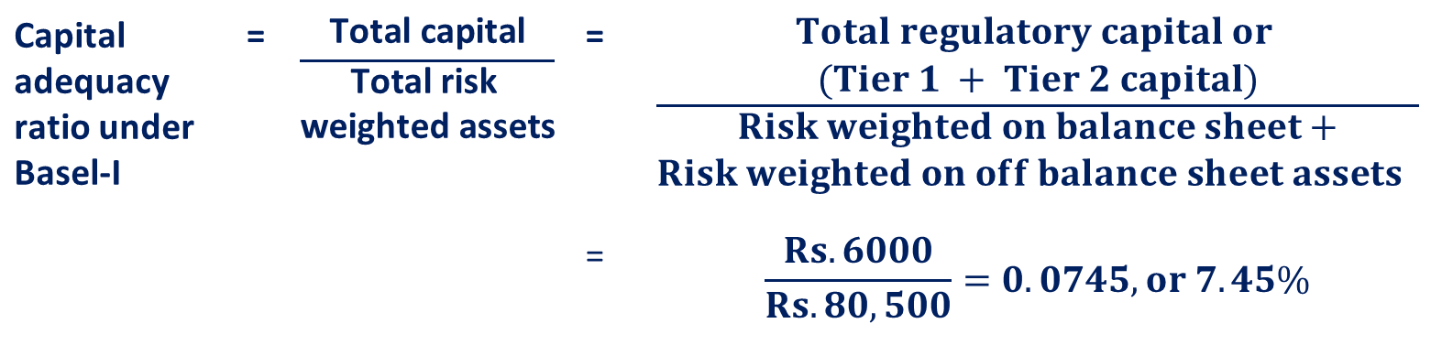
Calculating Risk Weighted Assets Under Basel I
Calculation of risk weighted assets:
Note: 7.45% is more than the required minimum of Tier I capital of 4 % but below the combined tier I + Tier II capital requirement of 8%
Capital adequacy ratio under Basel-I | = | $$\frac{\text{Total} \text{capital}}{\begin{aligned}\text{Total} \text{r}\text{isk} \\ \text{weighted} \text{assets} \\ \end{aligned}}$$ | = | $$\frac{\begin{aligned}Total regulatory capital or \\ (Tier 1 + Tier 2 capital)\end{aligned}}{\begin{aligned}Risk weighted on balance sheet+ \\ Risk weighted on off balance sheet assets \end{aligned}}$$
 |  |  | = | $$\frac{Rs.6000}{Rs.80,500}=0.0745, or 7.45\%$$

Slide 24
Basel I: Positive of Risk Adjusted Assets
Are sensitive to some extent to differences in bank risk taking
Incorporate off-balance sheet activities into risk assessments
Do not penalize banks for holding low-risk, liquid assets
Increase the consistency of rules applied to large banks around the world

Slide 25
Basel I: Problems With Risk Adjusted Assets
Only deals explicitly with credit risk.
The concept uses book values rather than market values.
Other types of risk ignored (operating, liquidity, and legal)
Portfolio diversification is ignored

Slide 26
Basel I: 1993 Proposal: Standard Model
Total Risk= Credit Risk+ Market Risk
Market Risk= General Market Risk+ Specific Risk
General Market Risk= Interest Rate Risk+ Currency Risk+ Equity Price Risk + Commodity Price Risk
Specific Risk= Instruments Exposed to Interest Rate Risk and Equity Price Risk

Slide 27
Basel I: 1996 Modification: Internal Model
Internal Model → Value at Risk Methodology
Tier III Capital (Only for Market Risk)
i) Long Term subordinated debt
ii) Option not to pay if minimum required capital is <8%

Slide 28
Basel I: Value at Risk (VAR) Models
Suppose a bank estimates its portfolio’s daily average value at risk is $100 million over a 10-day interval with a 99 percent level of confidence. Then, if this VaR estimate of $100 million is correct, losses in portfolio value greater than $100 million should occur less than 1 percent of the time. More precisely, the bank’s management anticipates losing at most $100 million for 99 out of 100 ten-day intervals.
An analysis of the bank’s historical distribution of losses in its trading portfolio will indicate whether this estimate is reasonable or not.
Management would want to compare the estimated future loss to the bank’s current level of equity capital to make sure the institution is sufficiently capitalized in order to avoid failure
If management determines that its VaR estimates are rising, the bank must consider either increasing the amount of regulatory define capital it holds in order to absorb the rising level of risk or take steps to reduce its risk exposure.

Slide 29
Basel II
Aims to correct the weaknesses of Basle I
Three Pillars of Basel II:
Pillar I: Minimum Capital Requirements
Capital requirements for each bank are based on their own estimated risk exposure from credit, market and operational risks
Pillar II: Supervisory review
Supervisory review of each bank’s risk assessment procedures and the adequacy of its capital, solvency reports
Pillar III: Market Discipline
Greater disclosure of each bank’s true financial condition (market works), capital transparency, capital adequacy, risk measurement and management, risk profiting

Slide 30
Tier 1 Capital
Deemed to have highest capacity to absorbing losses in order to allow banks continue to operate on ongoing basis
Common shareholder equity
Disclosed Reserves
Published reserves derived from post-tax retained earnings and after dividend payments
Non-cumulative perpetual preferred stock

Slide 31
Tier 2 & 3 Capital
Tier 2 cannot exceed 100% of Tier 1 capital
Subordinated debt
Undisclosed reserves: availability is more uncertain
General loan loss reserves
Hybrid debt equity capital instruments
Tier 3 can be used to meet a proportion of the capital requirements of market risk
Consist of subordinated debt with some limitations
Tier II capital restricted to 100% of Tier-I capital; Long term subordinated debt to be < 50 % of tier-I capital
Tier III to be less than 250 %of Tier-I capital assigned to market risk, i.e., a minimum of 28.5 % of market risk must be covered by tier-I

Slide 32
Basel II: Amends over Basel I
Minimum capital requirements
Definition of capital is unchanged and the minimum capital requirement remains 8%, but risk-adjusted assets in the denominator will be calculated differently
Denominator of minimum total capital ratio will consist of 3 parts: the sum of all risk-weighted assets for credit risk, plus 12.5 times the sum of the capital charges for market risk and operational risk
Assuming that a bank has $875 of risk weighted assets credit risk, a market risk capital charge of $10 and an operational risk capital charge of $20, the denominator of the total capital ratio would equal 875 + [(10 + 20) x 12.5)] or $1,250

Slide 33
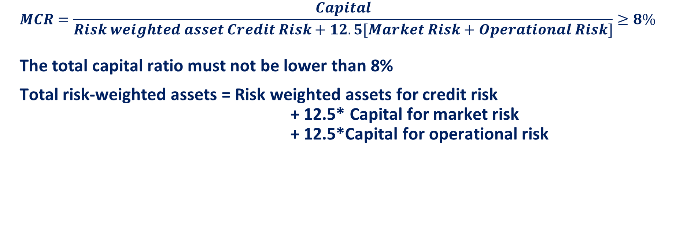
Basel II: Minimum Capital Requirement (MCR)
$$MCR=\frac{Capital}{Risk weighted asset Credit Risk+12.5[Market Risk+Operational Risk]}≥8\%$$
The total capital ratio must not be lower than 8%
Total risk-weighted assets = Risk weighted assets for credit risk
+ 12.5* Capital for market risk
+ 12.5*Capital for operational risk

Slide 34
Basel II: Minimum Capital Requirement (MCR)
Capital for credit risk
Standardized Approach
Internal Ratings Based Approach (IRB)
Foundation
Advanced
Credit risk mitigation
CDS & Counterparty risk
Securitization

Slide 35
Basel II: Minimum Capital Requirement (MCR)
Capital for credit risk
Standard approach
Based on ratings of External Credit Assessment Institutions ( ECAI ), satisfying seven requisite criteria and to be approved by national supervisors. A simplified standard approach (SSA) is also put in place.
Apply fixed risk weighting to assets based on:
Type of entity (Sovereign, Commercial bank, Corporates, retail, etc.)
Credit rating (AAA, Aaa,…, Bbb)

Slide 36
Basel II: Minimum Capital Requirement (MCR)
Capital for credit risk
Internal rating based (IRB) approaches :
Based on the bank’s internal assessment of key risk parameters such as, probability of default (PD), loss given at default (LGD), exposure at default ( ED), and effective maturity ( M ) etc.
Two approaches
Foundation: Bank produces own loss probability models (i.e. own credit ratings), but uses prescribed estimates of Loss Given Default (LGD) based on ratings
Advanced: Bank uses own loss probability models and LGD models

Slide 37
Basel II: Minimum Capital Requirement (MCR)
Capital for market risk
The risk of losses in on-balance sheet and off-balance sheet positions arising from movements in market prices.
Following Market risk positions require capital charge:
Interest rate related instruments in trading book
Equities in trading book
Forex open positions

Slide 38
Basel II: Minimum Capital Requirement (MCR)
Capital for market risk
The capital requirement is
where k is a multiplicative factor chosen by regulators (at least 3), VaR is the 99% 10-day value at risk, and SRC is the specific risk charge for idiosyncratic risk related to specific companies

Slide 39
Basel II: Minimum Capital Requirement (MCR)
Capital for market risk cont..
The minimum capital required comprises two components:
Specific charge for each security
General market risk charge towards interest rate risk in the portfolio
Capital charge for interest rate related instruments
Banks have to follow specific capital charges prescribed by RBI for interest rate related instruments. These charges range from 0 % to 9 % for different instruments and for different maturities.
As regards general market risk, RBI has prescribed ‘duration ’ method to arrive at the capital charge for market risk ( modified duration ).

Slide 40
Basel II: Minimum Capital Requirement (MCR)
Capital for operational risk
Basic Indicator Approach
Standardized Approach
Advanced Management Approach

Slide 41
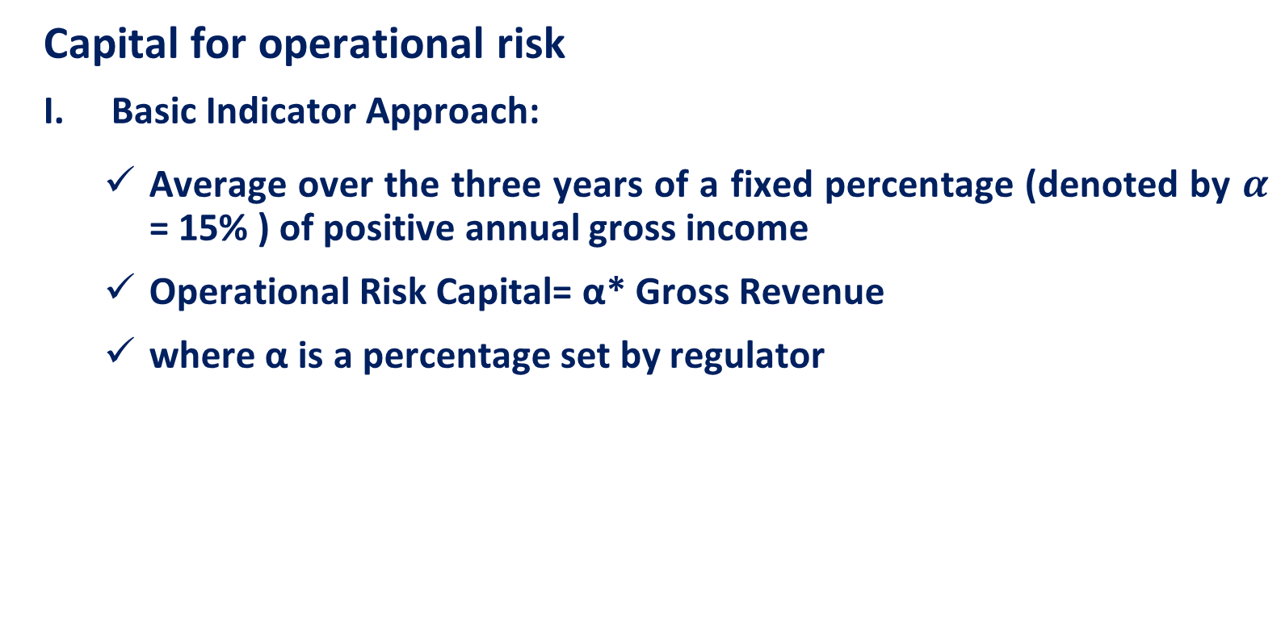
Basel II: Minimum Capital Requirement (MCR)
Capital for operational risk
Basic Indicator Approach:
Average over the three years of a fixed percentage (denoted by $α$ = 15% ) of positive annual gross income
Operational Risk Capital= α* Gross Revenue
where α is a percentage set by regulator

Slide 42
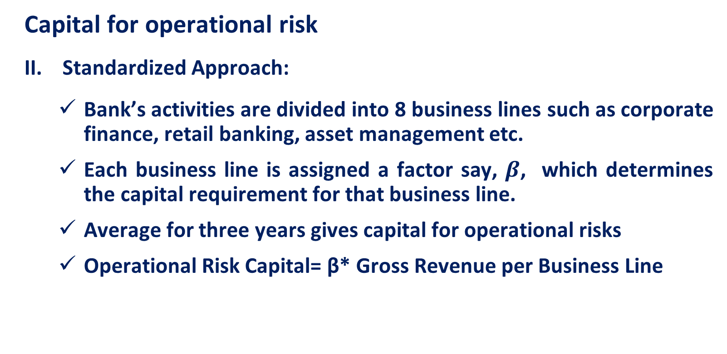
Basel II: Minimum Capital Requirement (MCR)
Capital for operational risk
Standardized Approach:
Bank’s activities are divided into 8 business lines such as corporate finance, retail banking, asset management etc.
Each business line is assigned a factor say, $β$, which determines the capital requirement for that business line.
Average for three years gives capital for operational risks
Operational Risk Capital= β* Gross Revenue per Business Line

Slide 43
Basel II: Minimum Capital Requirement (MCR)
Capital for operational risk
Advanced Management Approach
Bank’s internal risk measurement system is used after due vetting by the supervisor. As a minimum five year observation period of internal loss data is required this method may evolve over a period of time
Operational Risk Capital= the risk measure generated by the bank’s own operational risk measurement system

Slide 44
Basel II: Capital Standards
Banks are classified as being
Well Capitalized
Adequately Capitalized
Under Capitalized
Significantly Undercapitalized
Critically Undercapitalized

Slide 45
Basel II: Capital Standards
A. Well Capitalized
Total Capital to Risk Adjusted Assets ≥ 0.10
Tier 1 Capital to Risk Adjusted Assets ≥ 0.06
Tier 1 Capital to Total Assets ≥ 0.05 (Leverage Ratio)
B. Adequately Capitalized
Total Capital to Risk Adjusted Assets ≥ 0.08
Tier 1 Capital to Risk Adjusted Assets ≥ 0.04
Tier 1 Capital to Total Assets ≥ 0.04 (Leverage Ratio)

Slide 46
Basel II: Capital Standards
Under Capitalized:
(Depository institution that fails to meet one or more of the capital minimums for an adequately capitalized institution)
Total Capital to Risk Adjusted Assets < 0.08
Tier 1 Capital to Risk Adjusted Assets < 0.04
Tier 1 Capital to Total Assets < 0.04 (Leverage Ratio)
Significantly Undercapitalized:
Total capital ratio < 0.06
Tier I Capital < 0.03
No pay raises for senior officers, limits on deposit interest rates
Critically Undercapitalized:
Tangible equity capital to total assets is ≤ .02

Slide 47
Basel II: Strategies to Meet a Bank’s Capital Needs
Raising Capital Internally
Dividend Policy
Internal Capital Growth Rate
Raising Capital Externally
Issuing Common Stock-most expensive
Issuing Preferred Stock
Issuing Subordinated Notes and Debentures
Selling Assets and Leasing Facilities-often creates a substantial inflow of cash
Swapping Stock for Debt Securities-may get rid of sinking fund provisions
Choosing the Best Alternative

Slide 48
Why Basel-III?
Capital charge framework for market risk did not keep pace with new market developments and practices
Capital charge for market risk in trading book calibrated much lower compared to banking book positions on the assumption that markets are liquid and positions can be wound up or hedged quickly
Capital charge for specific risk (credit risk) in market risk framework (trading book) was lower than capital charge for credit risk in banking book

Slide 49
Why Basel-III?...
Capital charge for counterparty credit risk for derivative positions also covered only the default risk and migration risk was not captured
The global financial crisis mostly happened in the areas of trading book /off balance sheet derivatives / market risk and inadequate liquidity risk management
Banks suffered heavy losses in their trading book
Banks did not have adequate capital to cover the losses
Insufficient liquidity assets to raise finance during stressed period

Slide 50
Basel III: Enhancement to Basel II
During Pittsburgh summit in September 2009, the G20 leaders committed to
Strengthen the regulatory system for banks and other financial firms
Act together to raise capital standards
Implement strong international compensation standards aimed at ending practices that lead to excessive risk-taking
Improve the over-the-counter derivatives market and to create more powerful tools to hold large global firms to account for the risks they take
Consequently, the Basel Committee on Banking Supervision (BCBS) released comprehensive reform package entitled “Basel III: A global regulatory framework for more resilient banks and banking systems” (known as Basel III capital regulations) in December 2010

Slide 51
Basel III
Originally published in December 2010 in response to the global financial crisis and is expected to be phased in between 2013 and 2019
Raises both the quality and quantity of required regulatory capital bases
Objectives
Improving banking sector’s ability to absorb shocks
Reducing risk spillover to the real economy
Fundamental reforms proposed in the areas of
Micro prudential regulation – at individual bank level
Macro prudential regulation – at system wide basis

Slide 52
Basel III
Basel III reforms strengthen the bank-level i.e. micro prudential regulation, with the intention to raise the resilience of individual banking institutions in periods of stress
The reforms have a macro prudential focus- addressing system wide risks, which can build up across the banking sector, as well as the procyclical amplification of these risks over time
The macro prudential aspects of Basel III are largely enshrined in the capital buffers
Both the buffers i.e. the capital conservation buffer and the countercyclical buffer are intended to protect the banking sector from periods of excess credit growth

Slide 53
Basel III
Basel III strengthens the Basel II framework rather than replaces it
Whereas Basel II focused on the asset side of the balance sheet, Basel III mostly addresses the liabilities, i.e. capital and liquidity
The new framework will
Impose higher capital ratios, including a new ratio focusing on common equity
Increase capital charges for many activities, particularly involving counterparty risk
Narrow the scope of what constitutes tier 1 (T1) and tier 2 (T2) capital

Slide 54
Basel III: Framework
The Basel framework (continues to) consists of three pillars:
Pillar 1 : Calculations of regulatory capital requirements for credit, market and operational risk.
Pillar 2 : Process by which a bank should review its overall capital adequacy and the process under which the supervisors evaluate how well financial institutions are assessing their risks and take appropriate actions in response to the assessments
Pillar 3: Disclosure requirements for banks to publish certain details of their risks, capital and risk management, with the aim of strengthening market discipline. This is intended to improve effective risk management by allowing for comparison of the performance across sectors through these disclosure requirements.

Slide 55
Basel III: Framework-Capital
To improve the quality, consistency and transparency of the capital base the following changes are proposed under the new Basel III framework:
Increase of requirements on minimum Tier 1 (T1) capital
Increase in the standards for instruments to qualify as T1 capital
Harmonization of Tier 2 (T2) capital instruments and the elimination of Tier 3 (T3) capital
Revision of appropriate capital deductions such as minority interests and deferred tax assets

Slide 56
Basel III: Framework-Capital
The new minimum capital ratio:
The minimum requirement for common equity will be raised from the current 2% level to 4.5%
T1 capital requirement will increase from 4% to 6%
The capital conservation buffer above the regulatory minimum requirement must be calibrated at 2.5% and be met with common equity countercyclical buffer within a range of 0-2.5% of common equity or other fully loss-absorbing capital is implemented according to national circumstances.
This buffer is to be implemented by the national supervisor when there is excessive credit growth in the economy
These buffers are designed to restrict the bank’s ability to distribute its earnings until the buffers are rebuilt

Slide 57
Basel III: Framework-Capital
Systematically important financial institutions (SIFIs): global financial services firms - almost exclusively banks - so big that governments believe they will be forced to rescue these institutions rather than risk lasting damage to the world financial system
SIFIs should have loss absorbing capacity beyond the standards announced
The additional loss absorbency requirements are to be met with a progressive Common Equity Tier 1 (CET1) capital requirement ranging from 1% to 2.5%, depending on a bank’s systemic importance
For banks facing the highest SIB (systemically important bank) surcharge, an additional loss absorbency of 1% could be applied as a disincentive to increase materially their global systemic importance in the future

Slide 58
Basel III: Framework-Capital
Tier 1 capital: intended to ensure that each bank remains a “going-concern”
Highest quality form of a bank’s capital as it can be used to write off losses
Innovative hybrid capital instruments with step-up clauses are being phased out
Not included (i.e. deductions) in common equity are among others goodwill, minority interest, deferred tax assets, provisioning shortfalls, bank investments in its own shares and bank investments in other banks, financial institutions and insurance companies (to avoid double counting of equity)

Slide 59
Basel III: Framework-Capital
Tier 2 capital: intended to protect depositors in the event of insolvency; re-categorized as a “gone-concern” reserve
Subordinated debt remains eligible as T2 capital
Tier 3 capital is to be completely abolished
T3 capital is short-term subordinated debt and was used under Basel II to support market risk from trading activities

Slide 60
Basel III: Framework-Risk Coverage
Counterparty credit risk:
(Measures intended to address perceived deficiencies in Basel II during periods of acute market volatility)
Capital requirements must be determined using “stressed” inputs when calculating counterparty credit risk
Banks must implement a new capital charge - credit value adjustment (CVA) - to cover the risk of mark-to-market losses on the expected counterparty risk to OTC derivatives; this is additional to default risk capital charge

Slide 61
Basel III: Framework-Risk Coverage
Banks must implement a new capital charge for wrong-way risk.
Wrong-way risk: risk that arises when (credit) exposure at default is positively (adversely) correlated with the probability of default (i.e. the credit quality of the counterparty)→when default risk and credit exposure increase together
This will be achieved by adjusting the multiplier applied to the exposure amount identified as wrong way risk.
Apply a multiplier of 1.25 to the asset value correlation (AVC) of exposures to regulated financial firms with assets of at least $25 bn., since AVC’s were 25% higher during the crisis for financial versus non-financial firms

Slide 62
Basel III: Framework-Risk Coverage
Banks will be required to apply tougher (longer) margining periods (potential losses may occur over a longer specified period of time) to determine capital requirements when they have large and illiquid derivative exposures to a counterparty
Lower risk weightings (even zero weights) for counter-party risk exposure may be applied if they deal with centralized exchanges that meet certain criteria

Slide 63
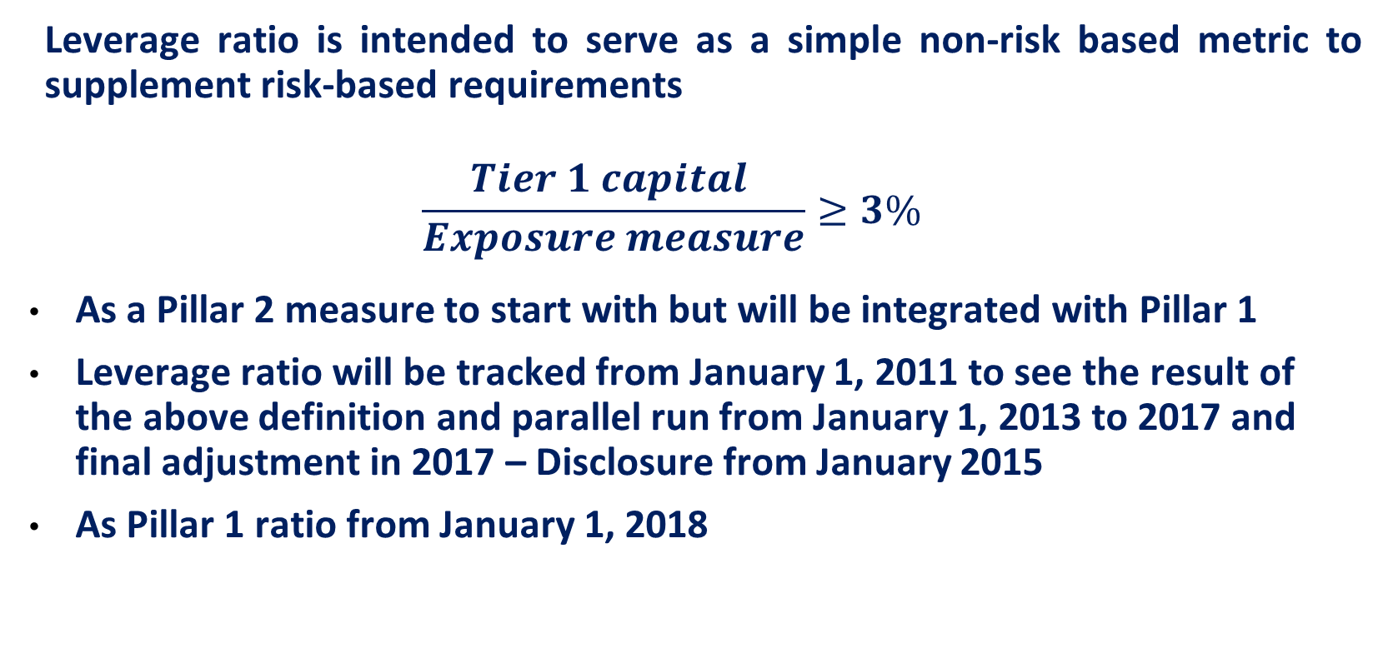
Basel III: Capital Leverage Ratio
Leverage ratio is intended to serve as a simple non-risk based metric to supplement risk-based requirements
$$\frac{Tier 1 capital }{Exposure measure}≥3\%$$
As a Pillar 2 measure to start with but will be integrated with Pillar 1
Leverage ratio will be tracked from January 1, 2011 to see the result of the above definition and parallel run from January 1, 2013 to 2017 and final adjustment in 2017 – Disclosure from January 2015
As Pillar 1 ratio from January 1, 2018

Slide 64
Capital Regulations in India

Slide 65
Basel III: Liquidity Metrics
Key characteristic of the financial crisis was inaccurate and ineffective management of liquidity risk
Two standards/ratios proposed
Liquidity Coverage Ratio (LCR) for short term (30 days) liquidity risk management under stress scenario
Net Stable Funding Ratio (NSFR) for longer term structural liquidity mismatches

Slide 66
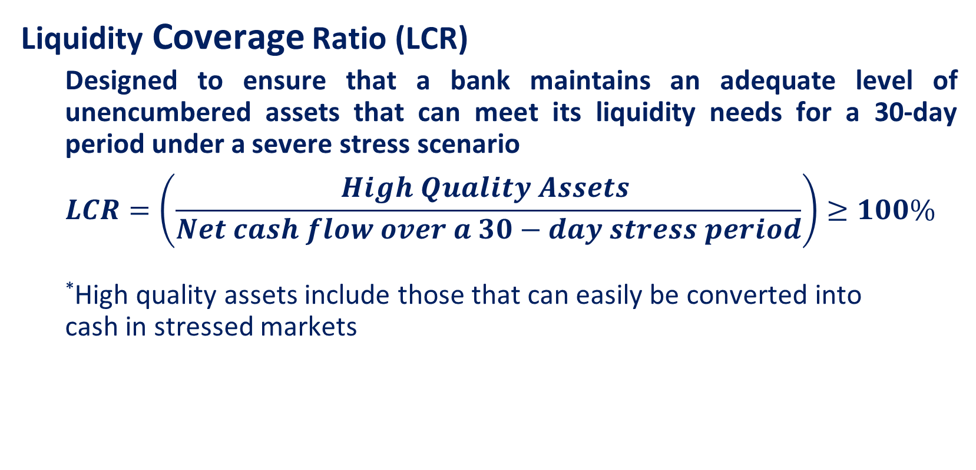
Basel III: Liquidity Metrics
Liquidity Coverage Ratio (LCR)
Designed to ensure that a bank maintains an adequate level of unencumbered assets that can meet its liquidity needs for a 30-day period under a severe stress scenario
$$LCR=\left(\frac{High Quality Assets }{Net cash flow over a 30−day stress period}\right)≥100\%$$
*High quality assets include those that can easily be converted into cash in stressed markets

Slide 67
Basel III: Liquidity Metrics
Fundamental characteristics of liquid assets
Low credit and market risk
Ease and certainty of valuation
Low correlation with risky assets
Listed in a developed and recognized exchange
Market-related characteristics
Active and sizable market
Presence of committed market makers
Low market concentration
Flight to quality

Slide 68
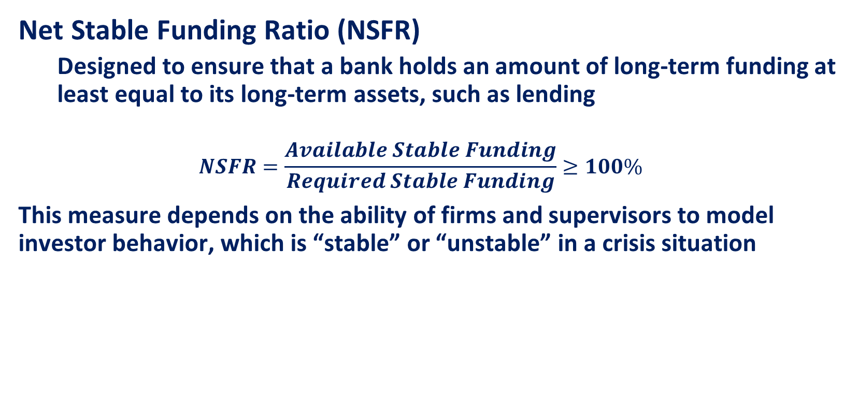
Basel III: Liquidity Metrics
Net Stable Funding Ratio (NSFR)
Designed to ensure that a bank holds an amount of long-term funding at least equal to its long-term assets, such as lending
$$NSFR=\frac{Available Stable Funding}{Required Stable Funding}≥100\%$$
This measure depends on the ability of firms and supervisors to model investor behavior, which is “stable” or “unstable” in a crisis situation

